Slide 5


Slide 6

Fine Art Tile Co.

Slide 7
Artisan Tile Co.

Slide 8
-1.5 of all
6
-2.5 of all
4
5
-2 of all
0
1
2
3
0
1
2
3
4
0
1
2
3
4
5
-1.5
-0.5
0.5
1.5
-2
-1
0
1
2
-2.5
-1.5
-0.5
0.5
1.5
2.5

Slide 9

Bonjour, je m'appelle Pierre!
Here at Pierre’s Artisan Tile Company we’ve been creating France’s most spectacular tile mosaics since 1473. I’ve been working here all my life, along with my father Pierre, and my grandfather Pierre.
We’ve just had our largest order since the company was formed, and we’re going to need some extra help around here.
Due to our extremely outdated manufacturing process, each mosaic arrives scrambled. It’s up to you to rearrange the tiles so our fabulous art can be displayed in its full glory!
Right, let’s get going!
Continue

Slide 11
Play

Slide 12


Slide 13
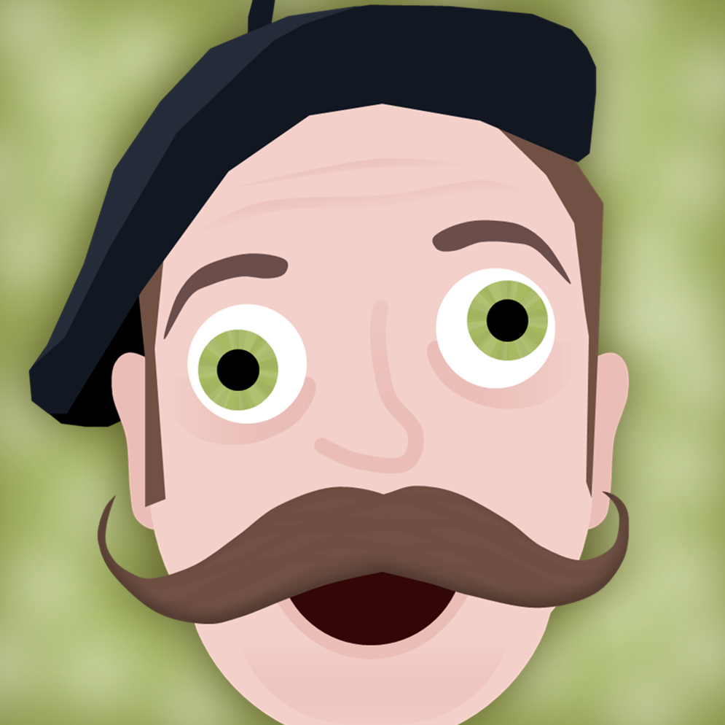

Slide 14

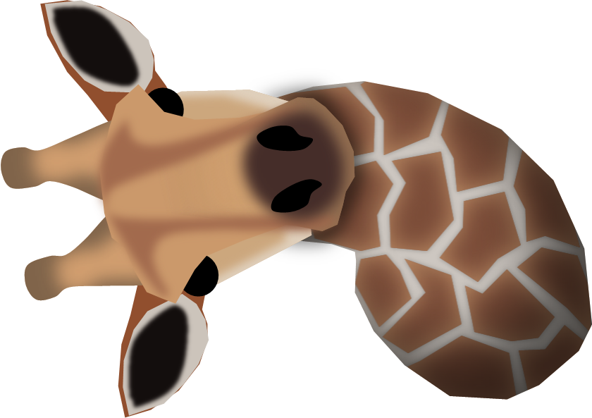

Slide 15

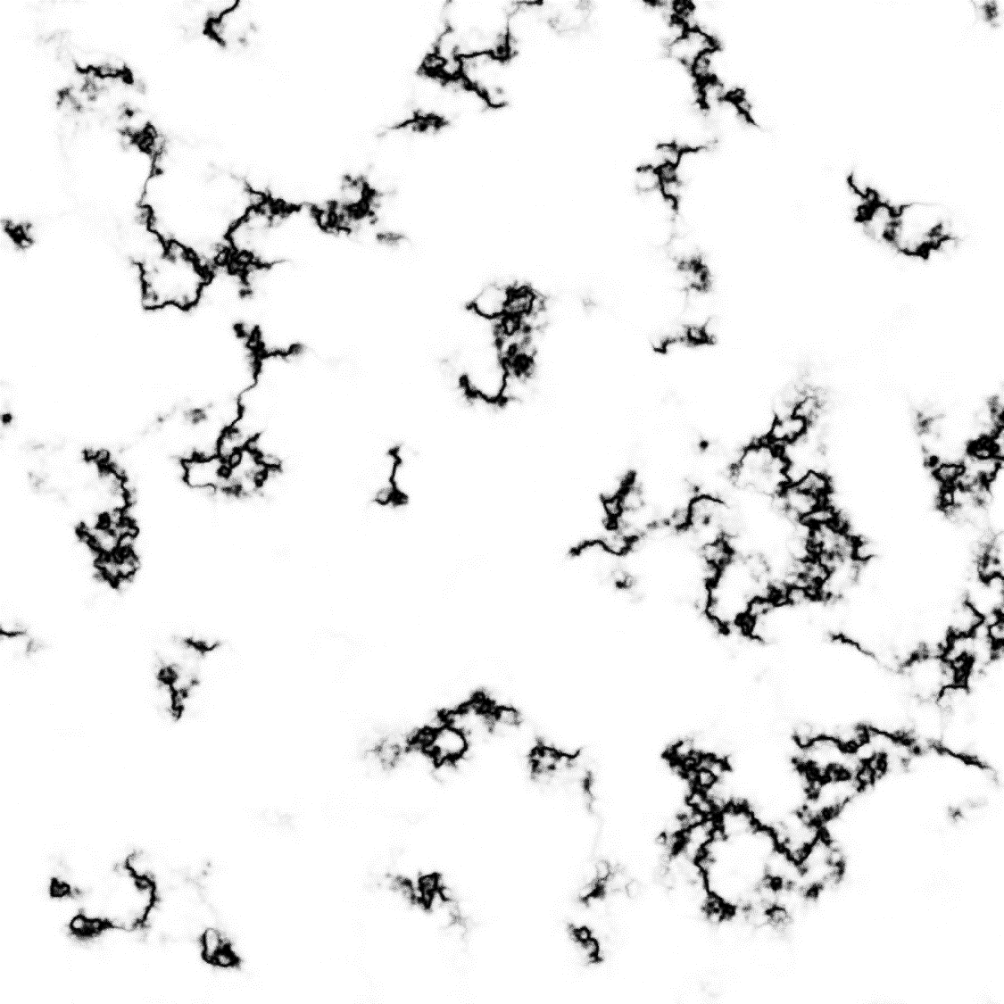

Slide 16
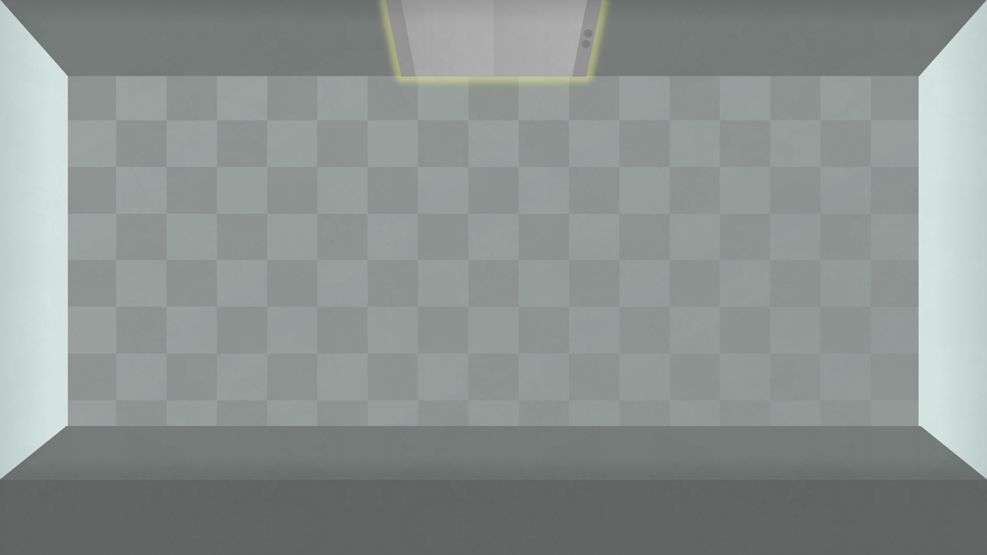




Slide 17


Slide 18
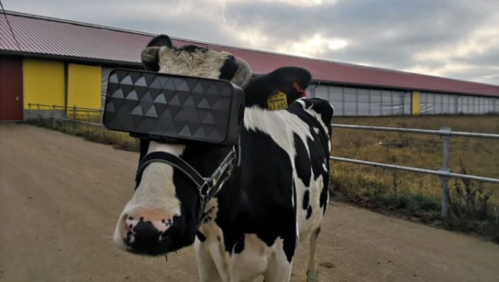
VR

Slide 19



Slide 21


Slide 22
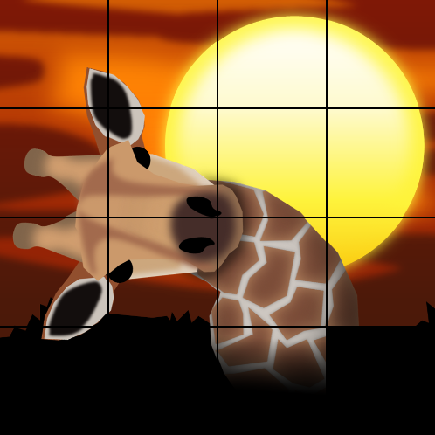
Puzzle Name
Moves
Time
Start

Slide 23
Puzzle Name
Moves:
0
Time:
00:00
Start
2x2
Return to Menu

Slide 24
Moves:
Time:

Slide 25
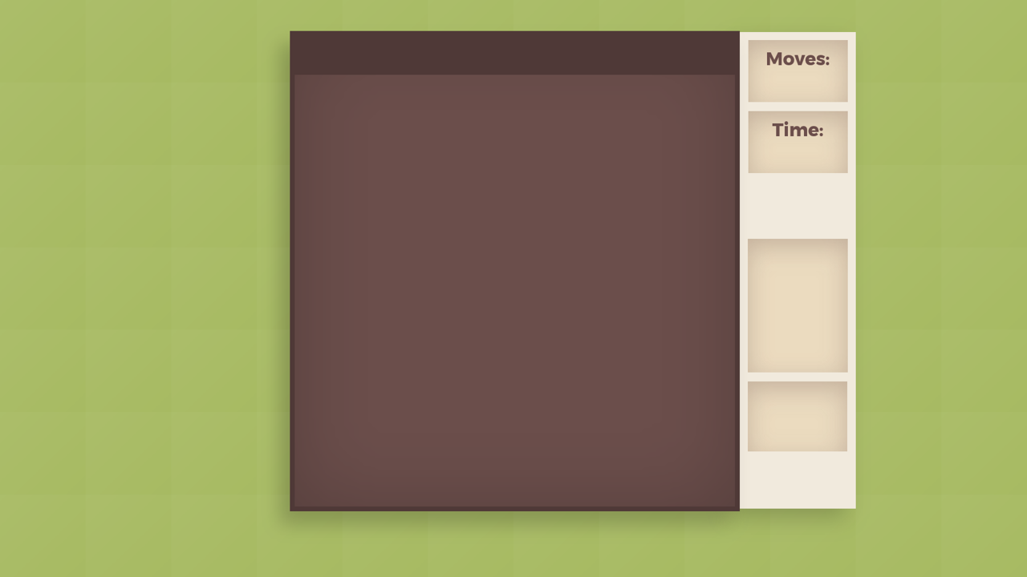
Time Limit:

Slide 26


Slide 30
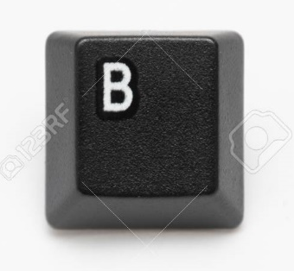
Misleading icons
Tile shake
Comments
Shuffle could happen 1 tile at a time
Reflection: “Looking back”, “In hindsight”

